Slide 1
Lower
Visual Level
Visual feature Semantics
Object Semantics
Semantic Gap
Object Level
Spatial Relationship Semantics
Higher
Scene Semantics
Notion Level
Behavior Semantics
Emontinal Semantics
Notes:
Figure 1

Slide 2









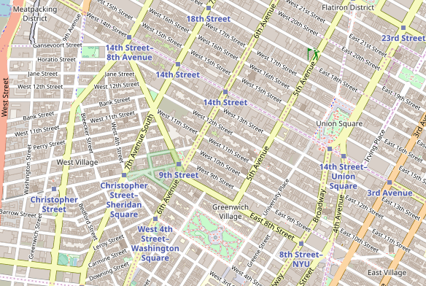

Database generation
(B)
…
Candidate route vectors
(D)
(A)
Locations
Generate candidate route vectors
Feature Extraction
Route generator
(C)
(E)
Junction
F
…
…
No junction
(F)
R
Distance
Ranked list of likely routes
…
B
Gaps
L
Query: route vector
(G)
…
…
No gap
Location images
Notes:
Figure 2

Slide 3
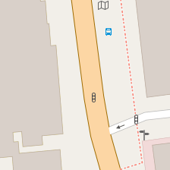
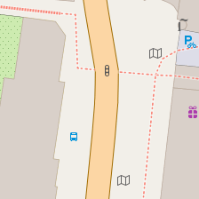
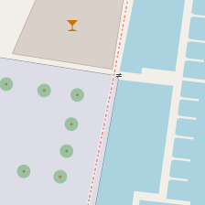
Embedded
space
Geolocated map tiles
…
(B)
Candidate route vectors
(A)
…
Locations
Generate candidate route vectors
Route generator
…
…
(C)
(D)
…
(E)
16-D embedded space vector
F
R
Feature Extractor
(F)
Distance
Ranked list of likely routes
B
…
L
…
(G)
Location images
Query: route vector
Notes:
Figure 2

Slide 4
Embedded
space
Geolocated map tiles
…
(B)
Candidate route vectors
(A)
…
Locations
Generate candidate route vectors
Route generator
…
…
(C)
(D)
…
(E)
32-D embedded space vector
F
R
Embedded
space
(F)
Distance
Ranked list of likely routes
B
…
L
Query: route vector
(G)
Location images
Notes:
Figure 2

Slide 5
Network
Database generation
Candidate route vectors
(B)
(A)
(D)
Locations
Route generator
Generate candidate route vectors
Feature Extraction
(C)
…
(E)
…
F
(F)
Network
Distance
…
R
…
B
…
L
…
(G)
Ranked list of likely routes
Location images
Query: route vector
Notes:
Figure 2

Slide 6
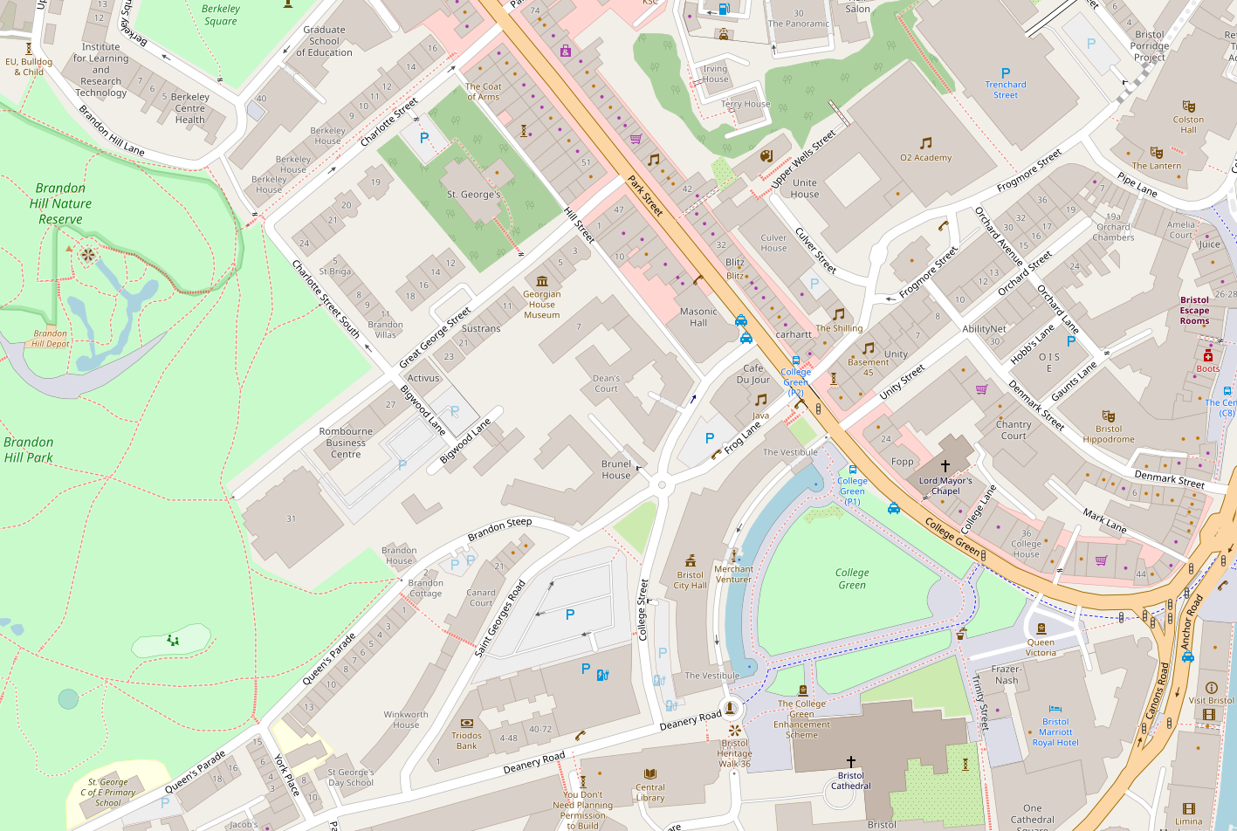
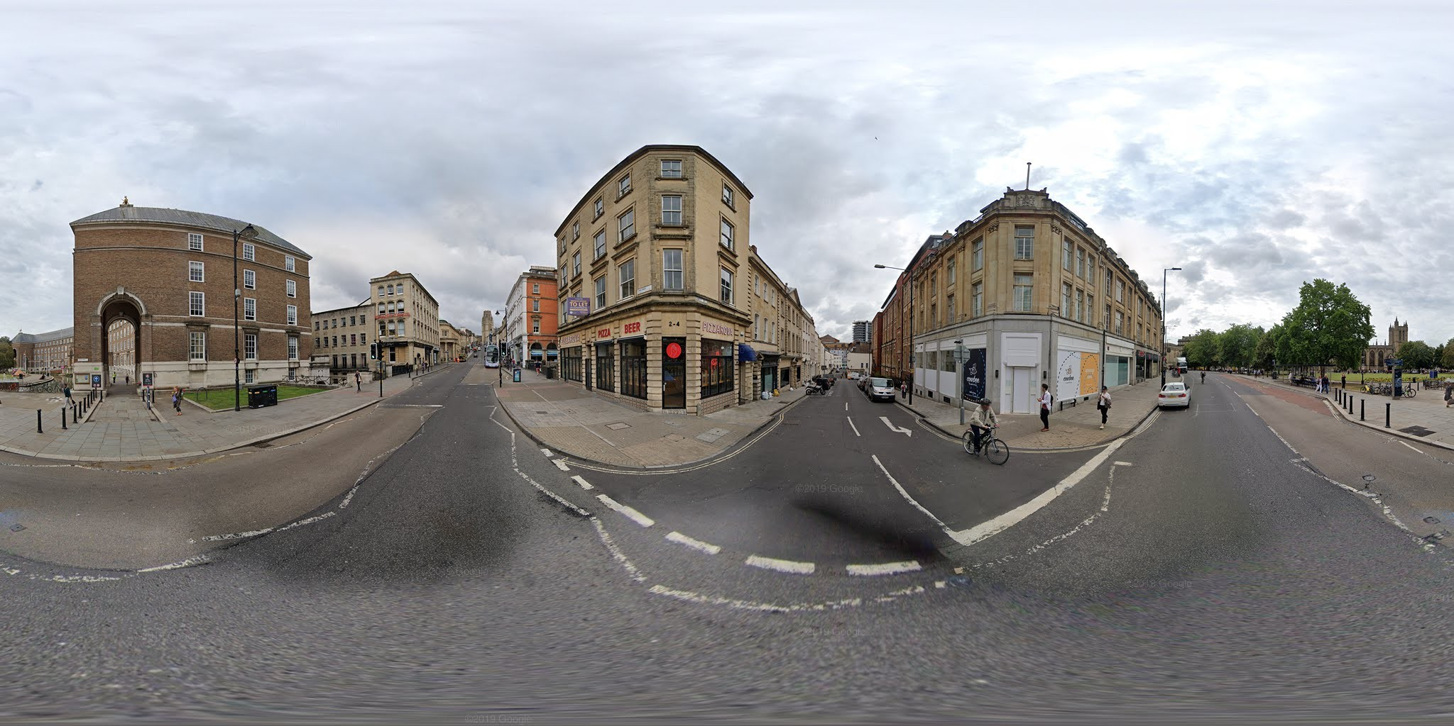
Building
Building
Road name
Building
junction
Building set
Building name
intersection
(a)
(b)
Notes:
Figure 3

Slide 7
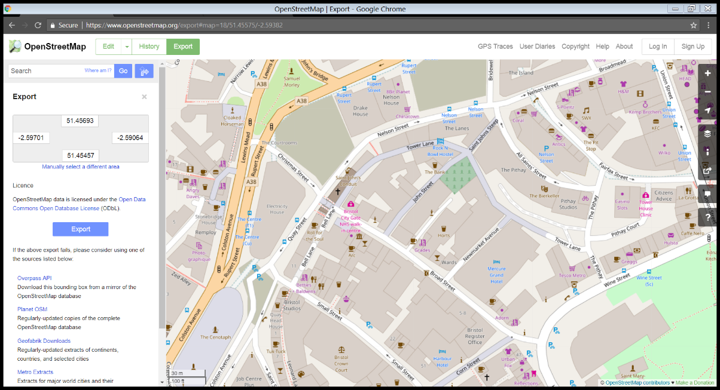
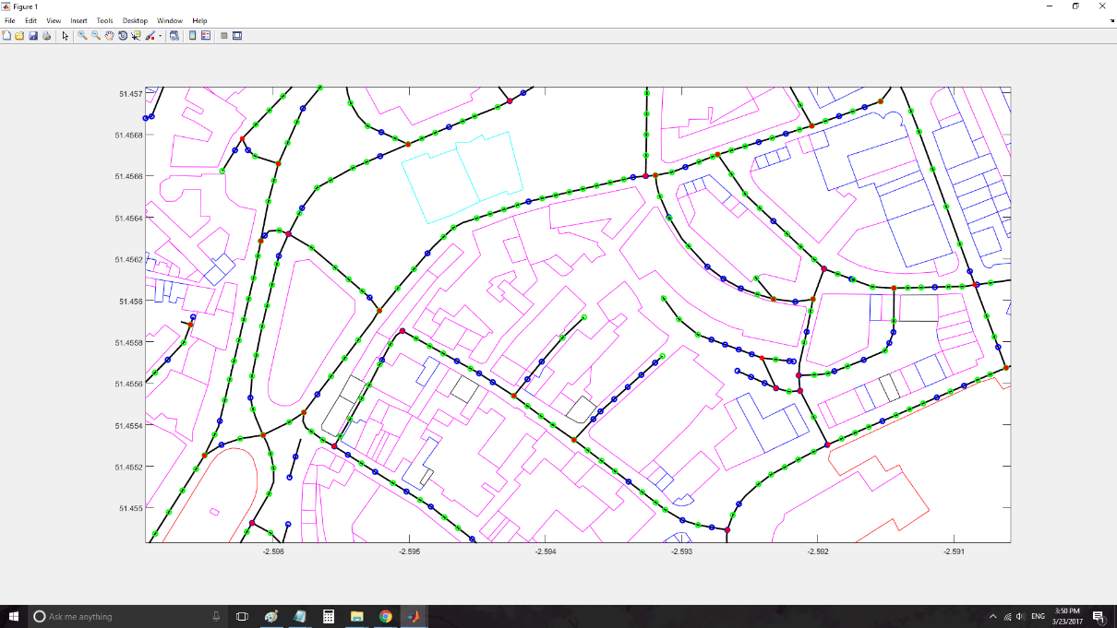
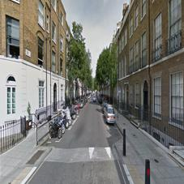
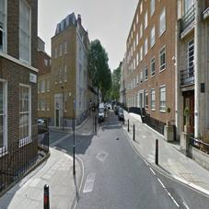
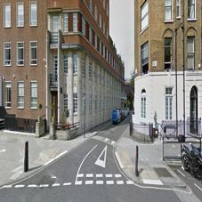
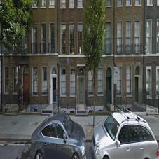
Images: Google Street View (GSV)
2D-map: Open Street Map (OSM)
Right
Front
Right
Front
Left
Back
Back
Left
gap between
buildings
OR no gap
junction
OR no junction
gap between
buildings
OR no gap
junction
OR no junction
junction
junction
Front
Front
Left
Right
Left
Right
4 bit descriptor
no gap
gap
no gap
gap
4 bit descriptor
Back
Back
no junction
no junction
Notes:
Figure 4

Slide 8
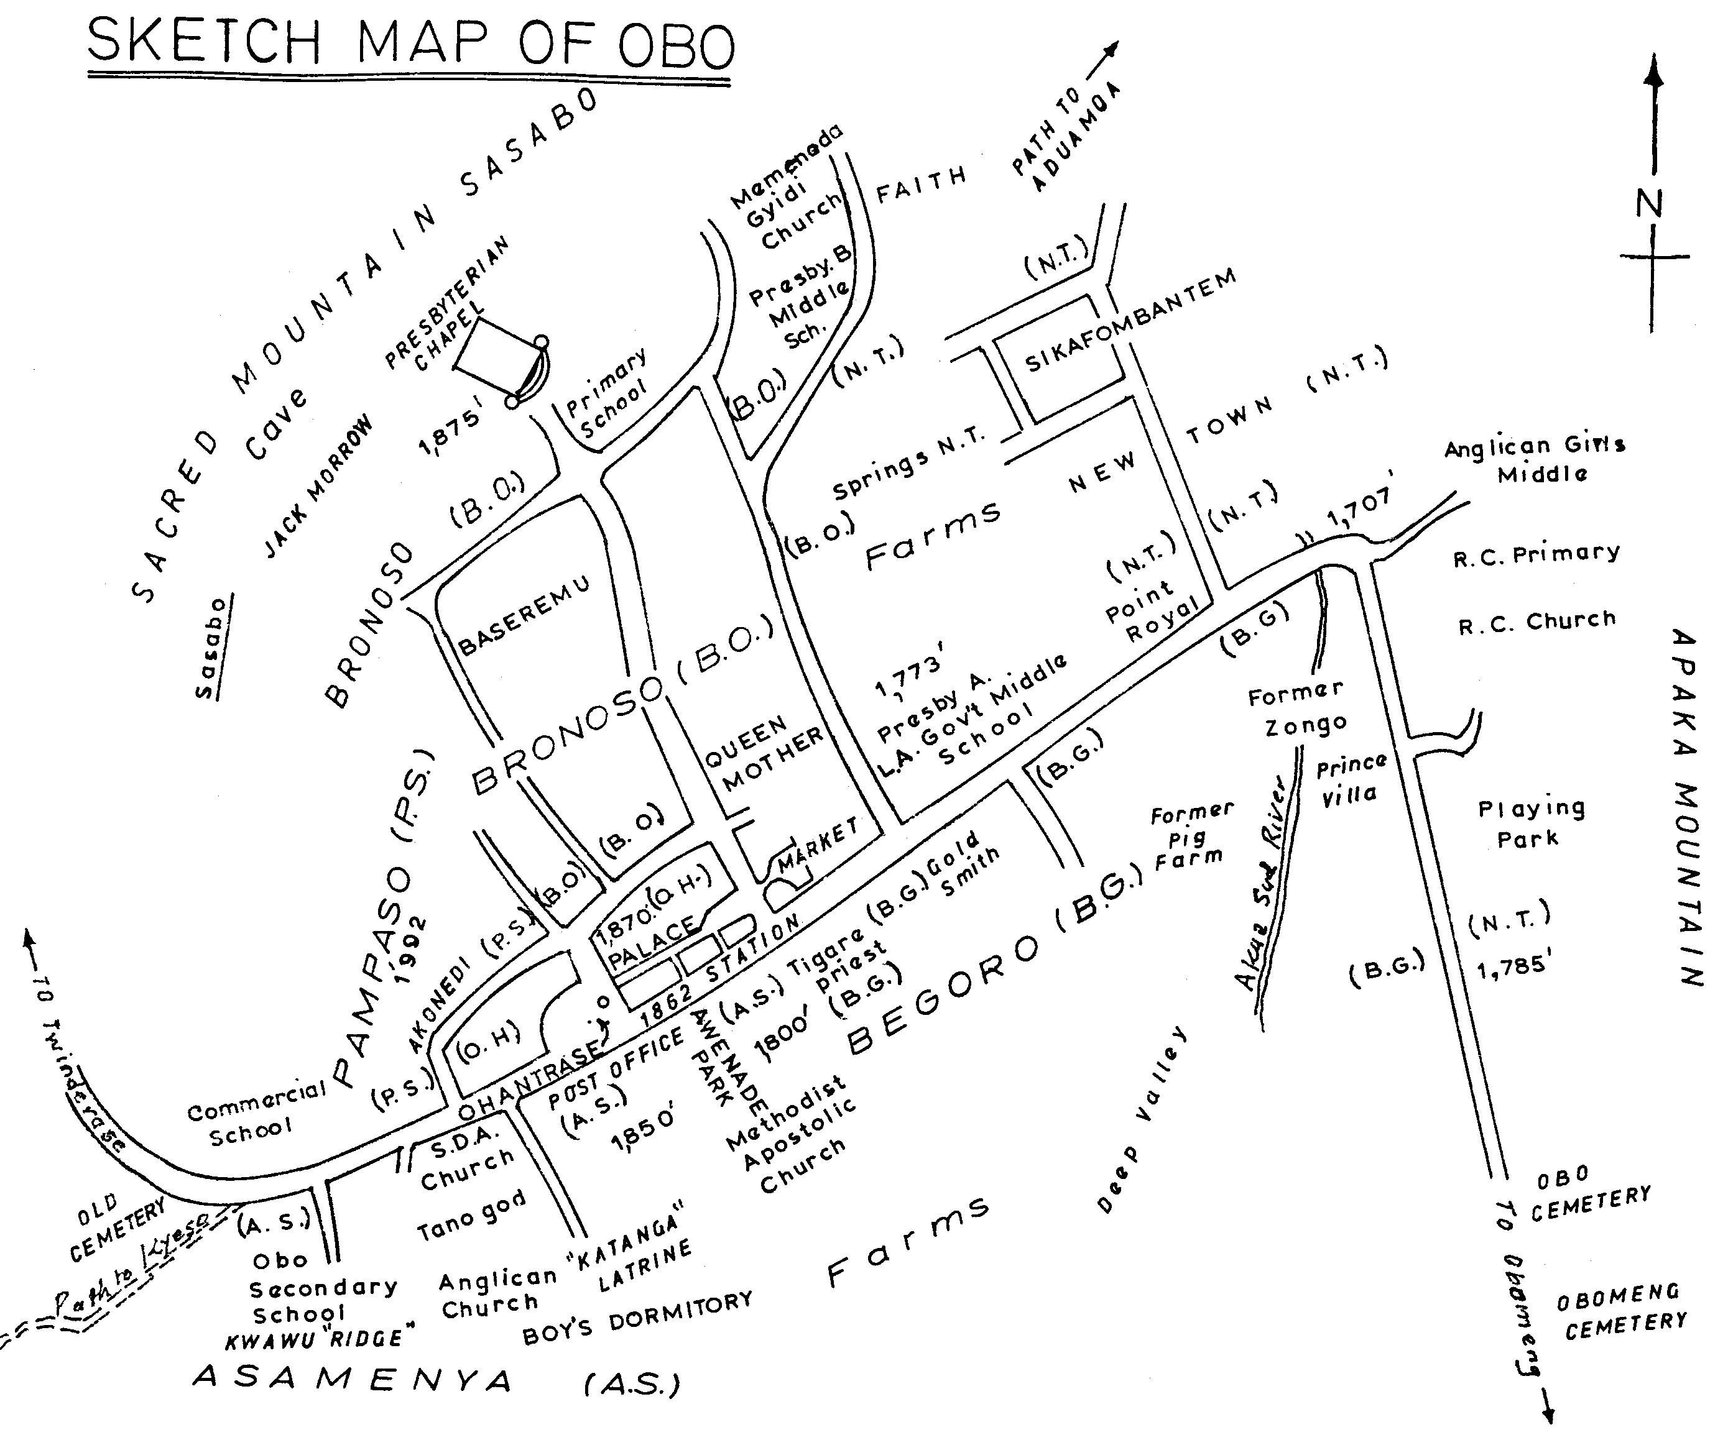
(a)
(b)
(c)
Notes:
Figure 5 different maps

Slide 9
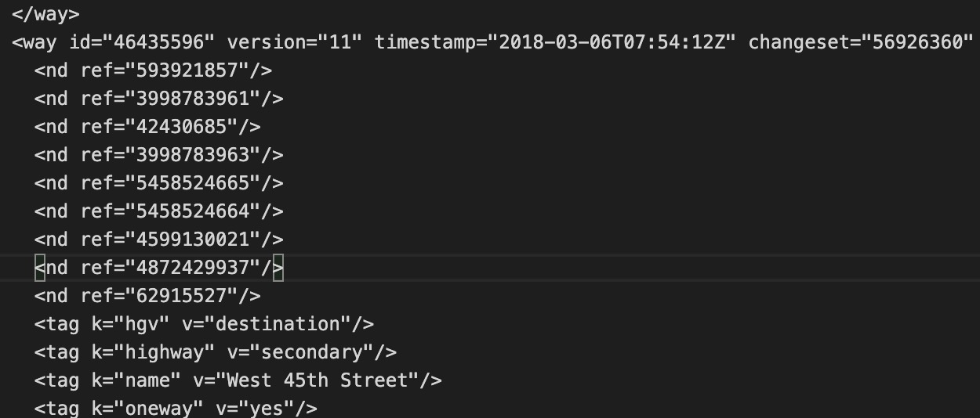
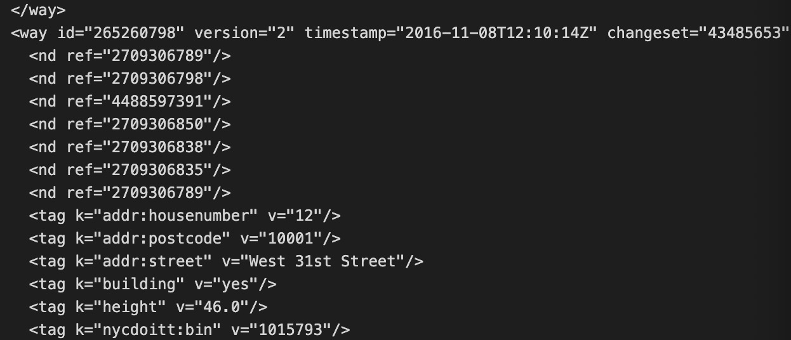
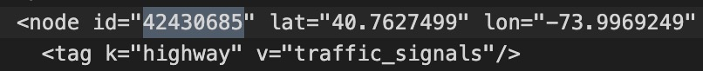
(a)
(b)
Notes:
Figure 6 OSM files

Slide 10
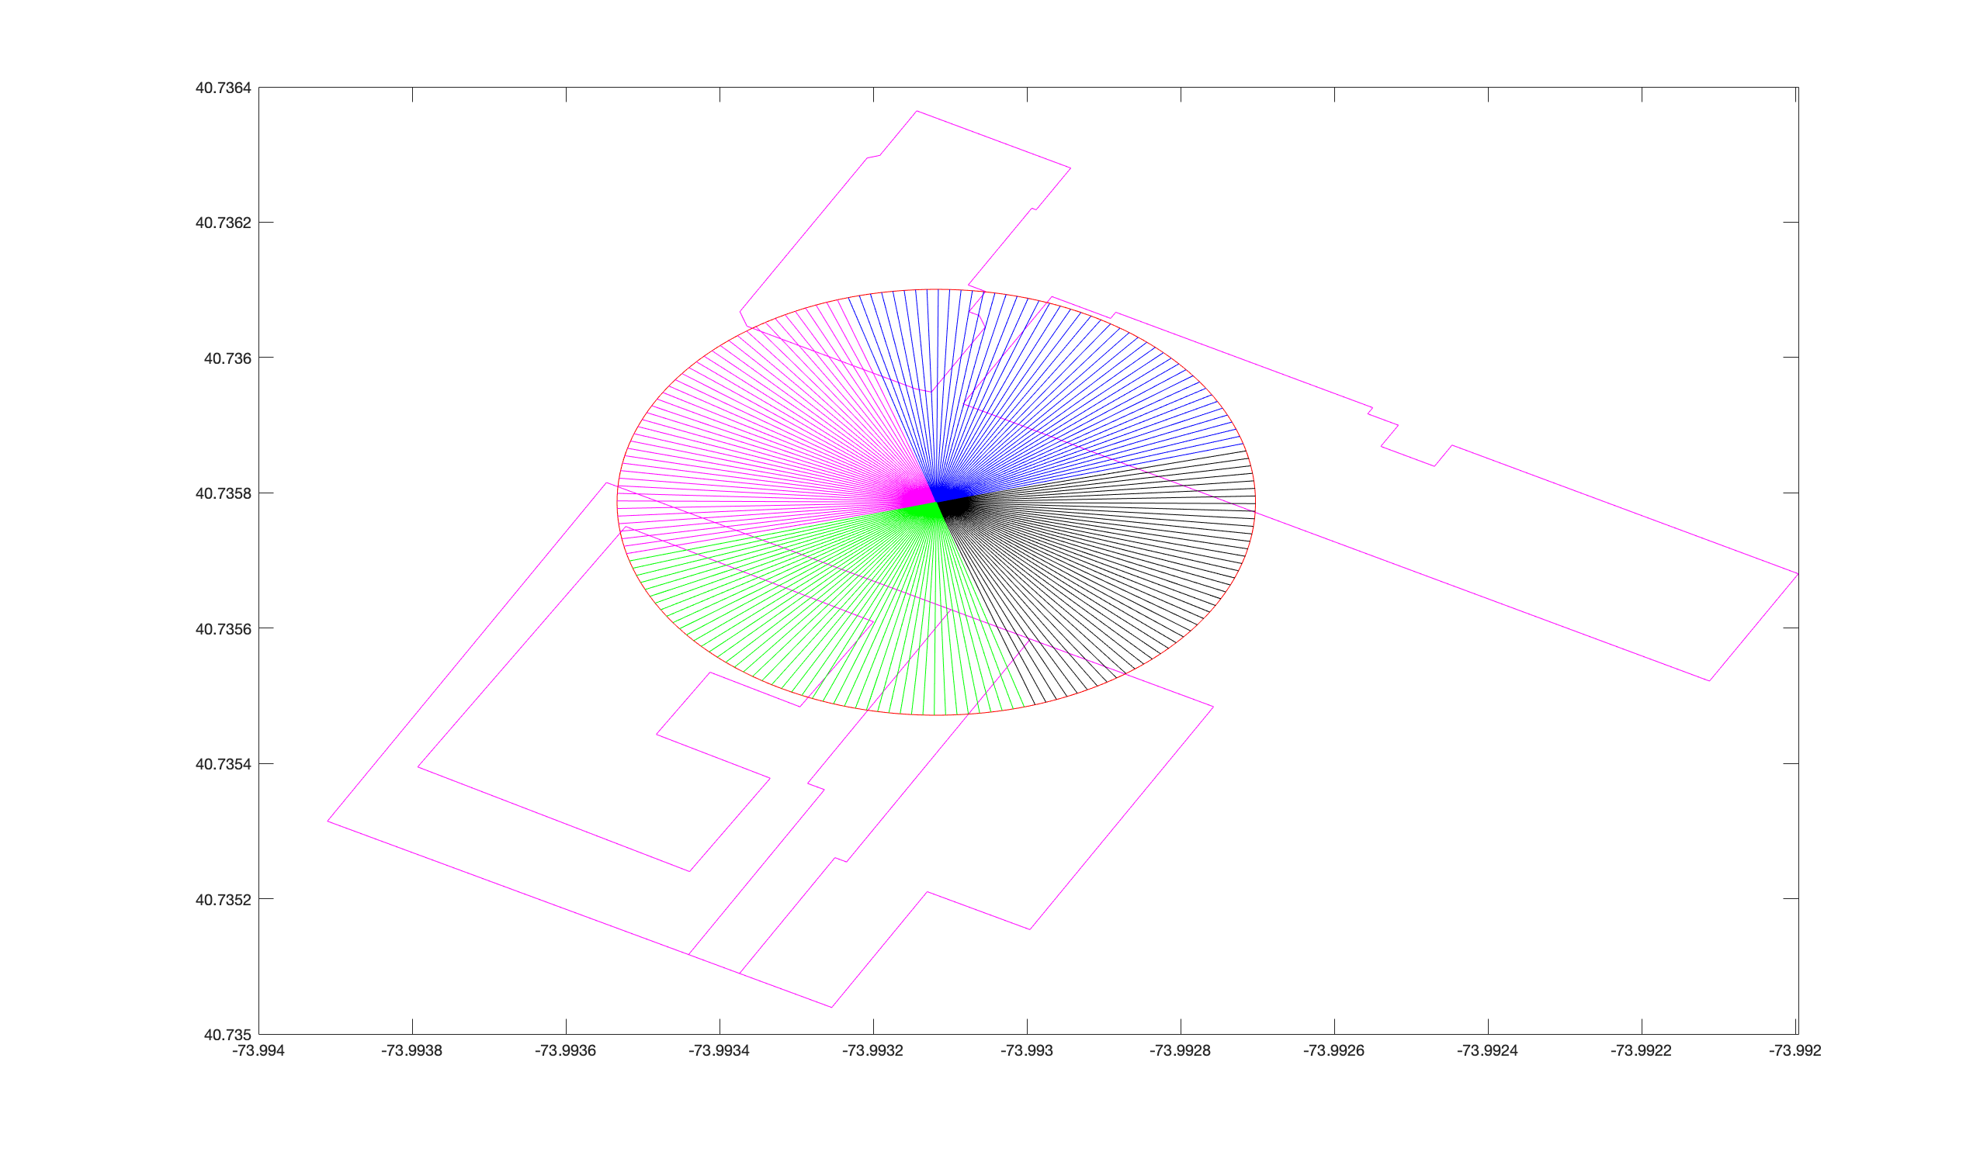
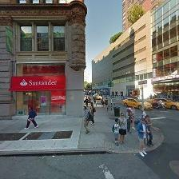
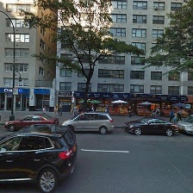
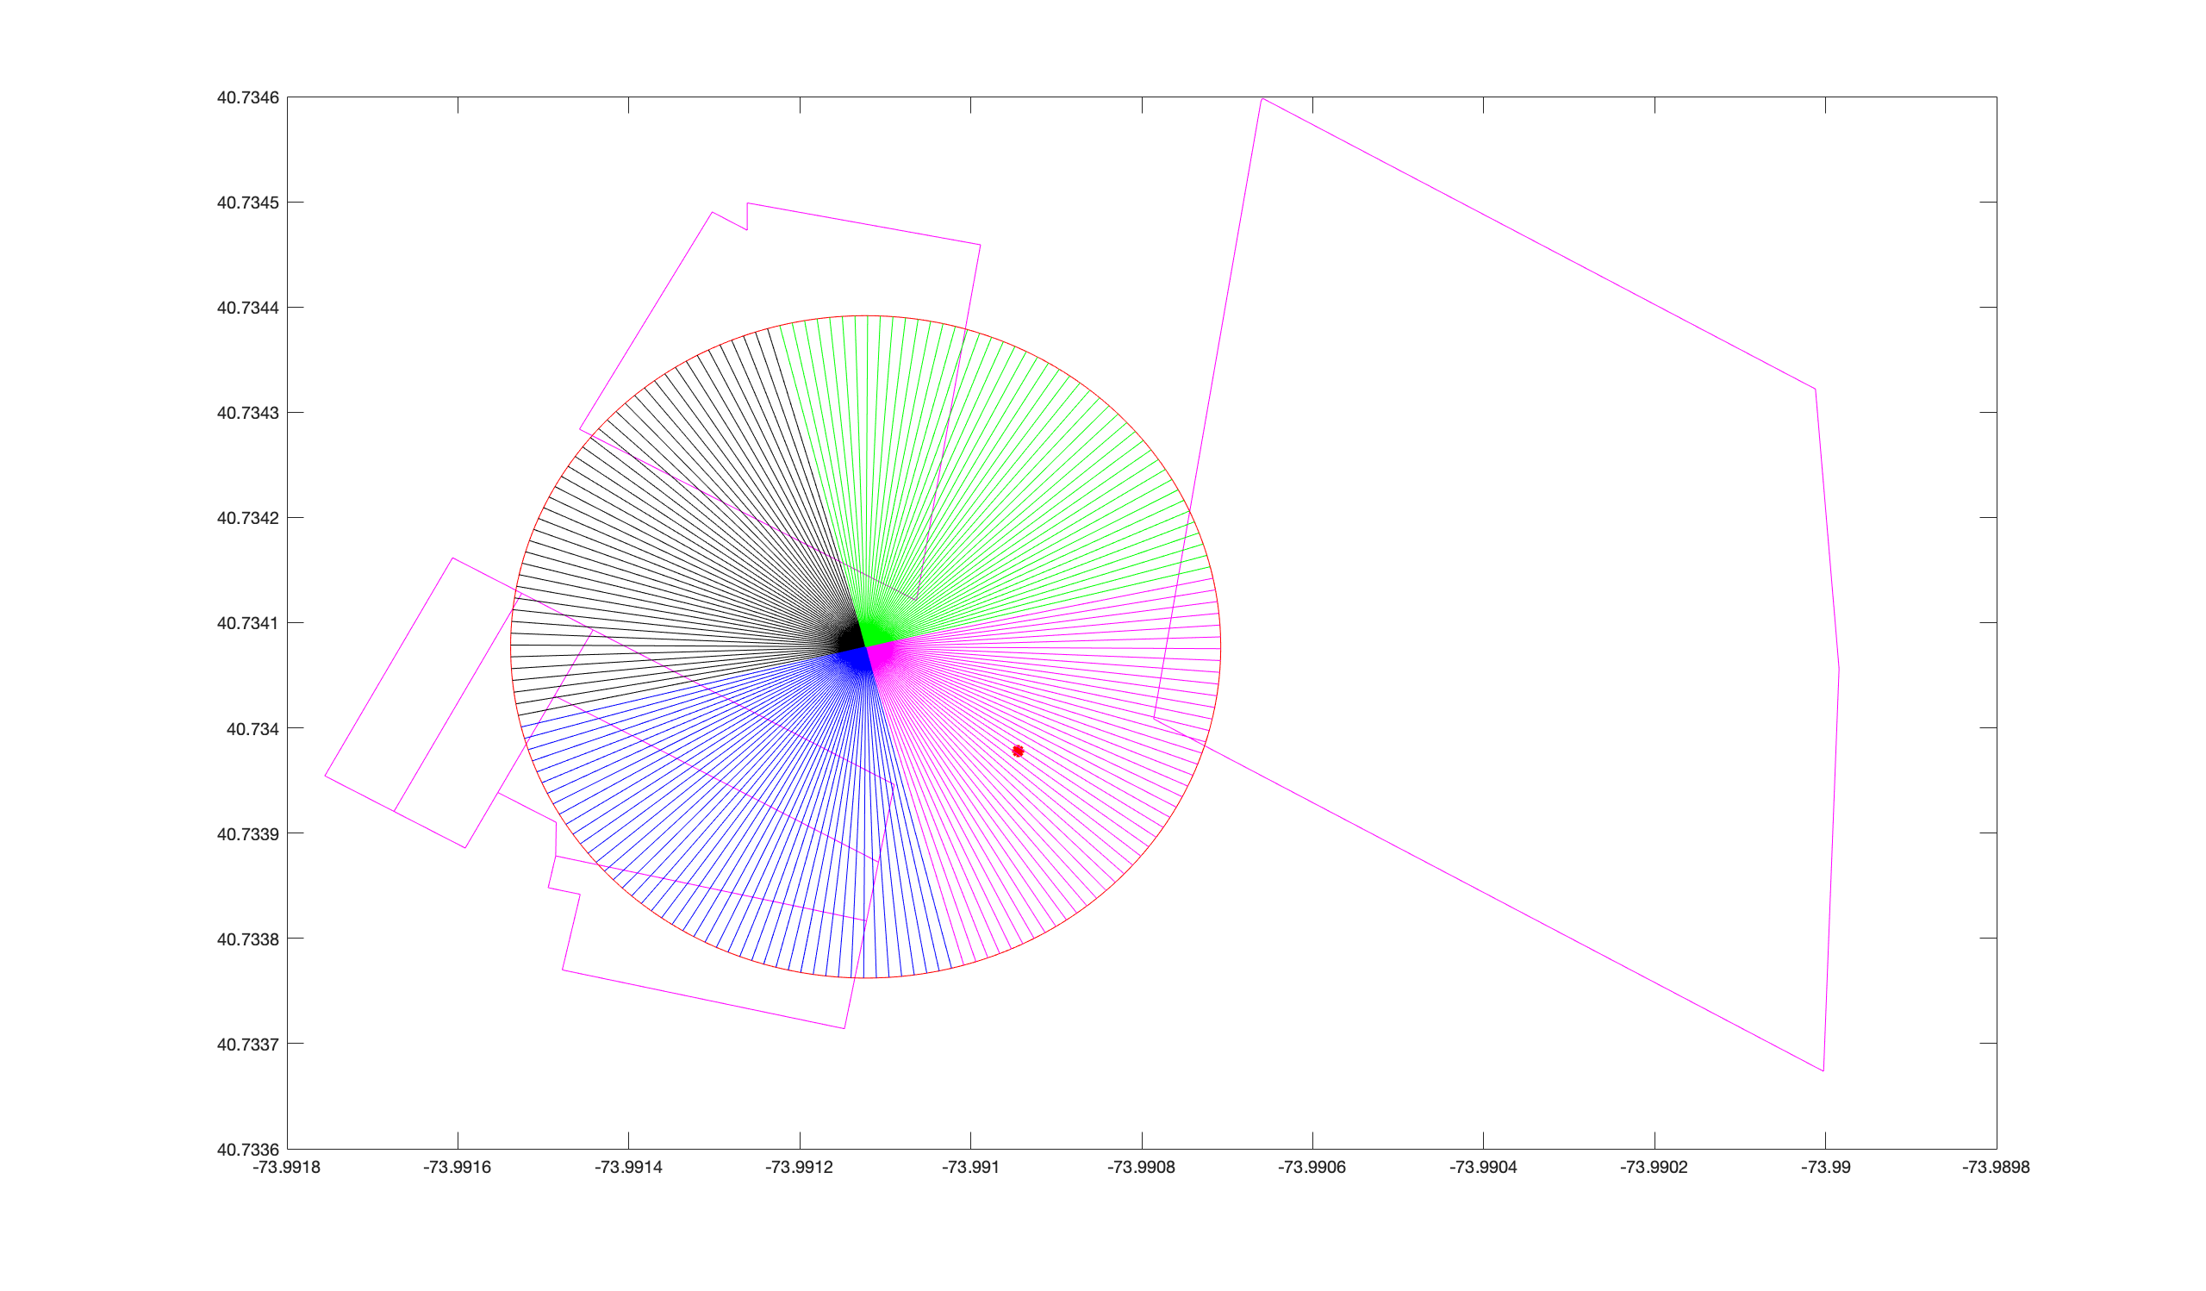
No intersctions
> 5m
Left
Front
Right
Back
Front
Left
Right
Back
junction
(a)
(b)
Notes:
Figure 7, Gaps extraction

Slide 11


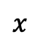

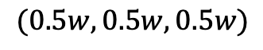
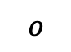
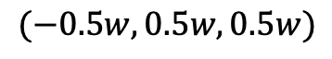
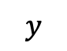
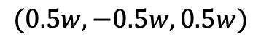
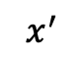
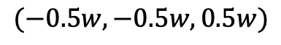
$$x$$
Cube face
$$(−0.5w,−0.5w,0.5w)$$
$$(0.5w,−0.5w,0.5w)$$
$$x^{′}$$
$$w × w$$
$$y$$
$$R$$
$$(0,0,0.5w)$$
$$o$$
equirectangular
$$(−0.5w,0.5w,0.5w)$$
$$(0.5w,0.5w,0.5w)$$
(a)
(b)
Notes:
Figure 9

Slide 12
x
x
Weight layer
Weight layer
ReLu
F(x)
ReLu
Identity
x
Weight layer
Weight layer
ReLu
H(x)
+
H(x) = F(x) + x
(a)
(b)
Notes:
Figure 10

Slide 13
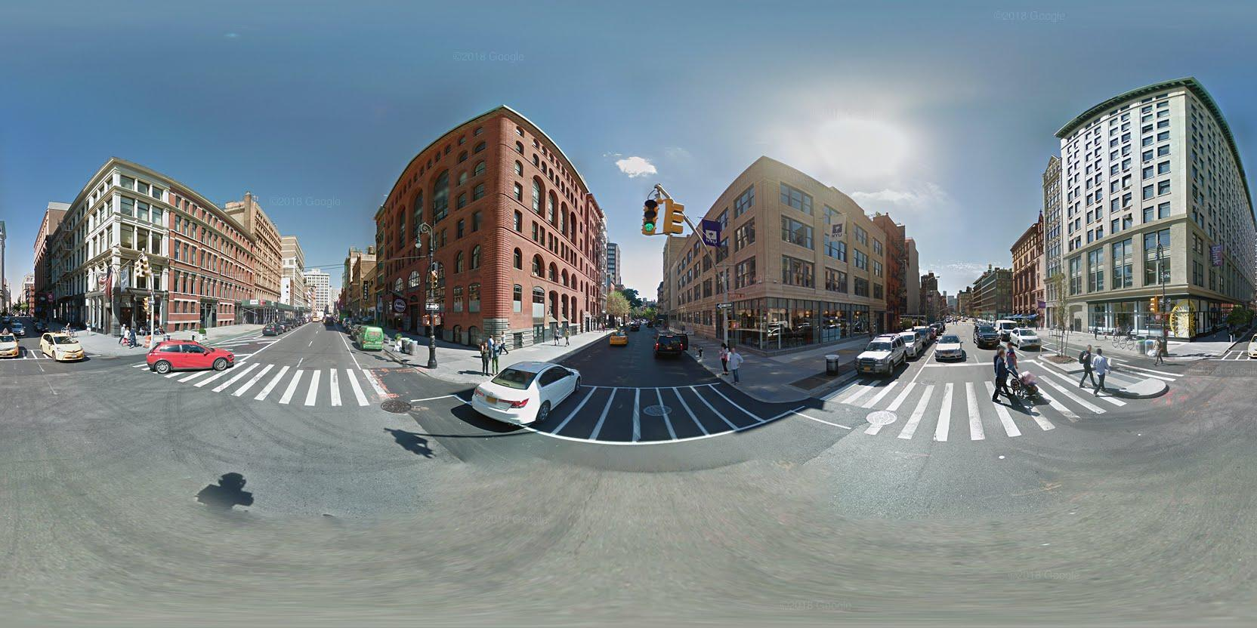
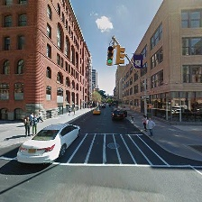
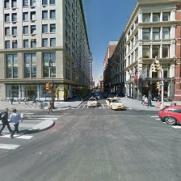
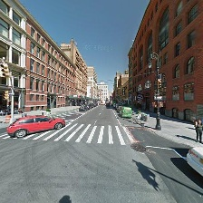
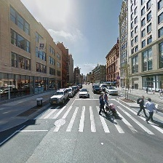
Google Street View
Equirectangular
Projection
Front
Back
Left
Right
Junction
OpenStreetMap
…
…
…
…
Non junction
Generate Labels
…
Gaps
…
…
…
…
Non gap

